Slide 1

The number ONE reason buyers come to the show is to see your New/Featured Products!
Effective way to display your product and get the BUYERS’ attention
Increase awareness of your product
Boost conversions and increase the number of leads for your business
Stand out from your competitors
Direct BUYERS to your booth

Slide 2
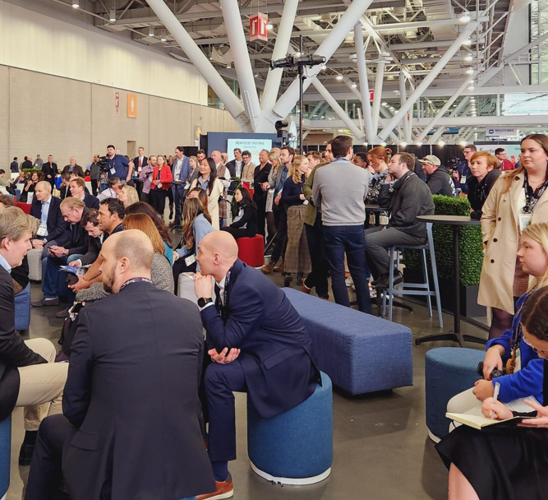
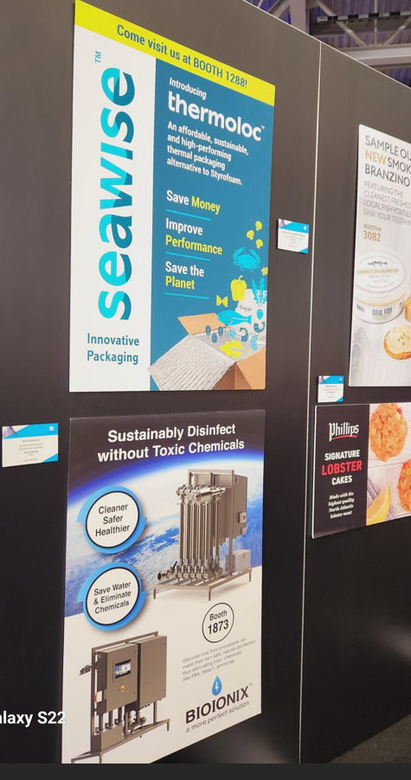
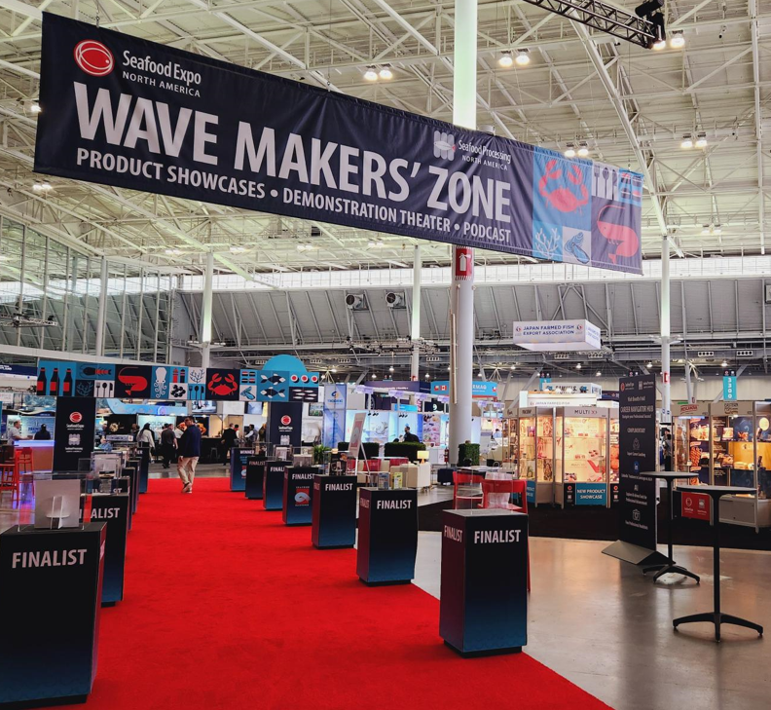
The Wave Makers' Zone is a popular networking hub for industry leaders. Take full advantage of this heavily trafficked area by introducing buyers to your latest innovative products in the New/Featured Product Showcase.

Slide 3
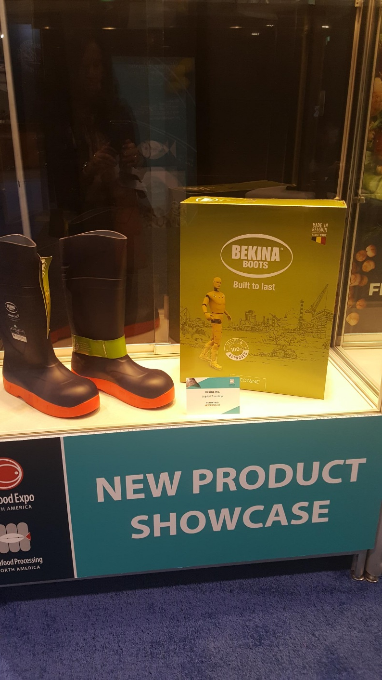
Single Display
$700

Slide 4
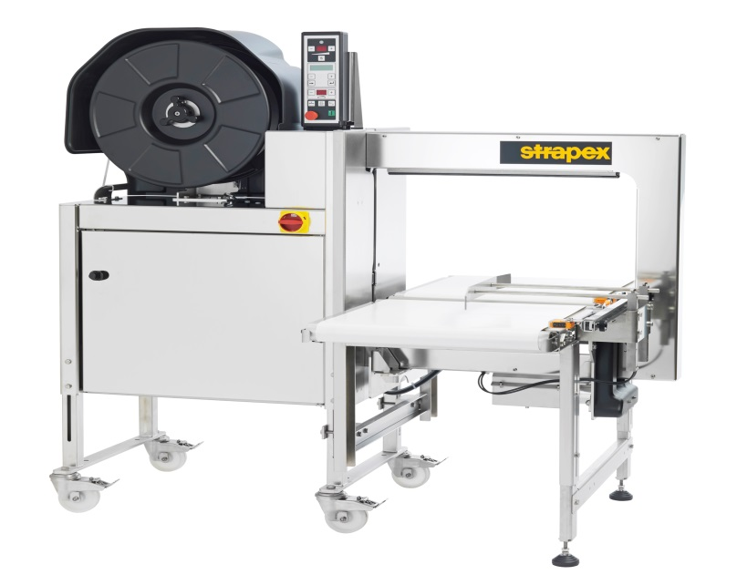

Equipment Poster Display 2x3’ or 3x2’ - $700

Slide 5
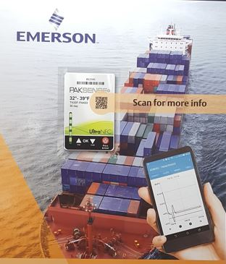
Full Poster Panel: 3x4’
$1,115

Slide 6
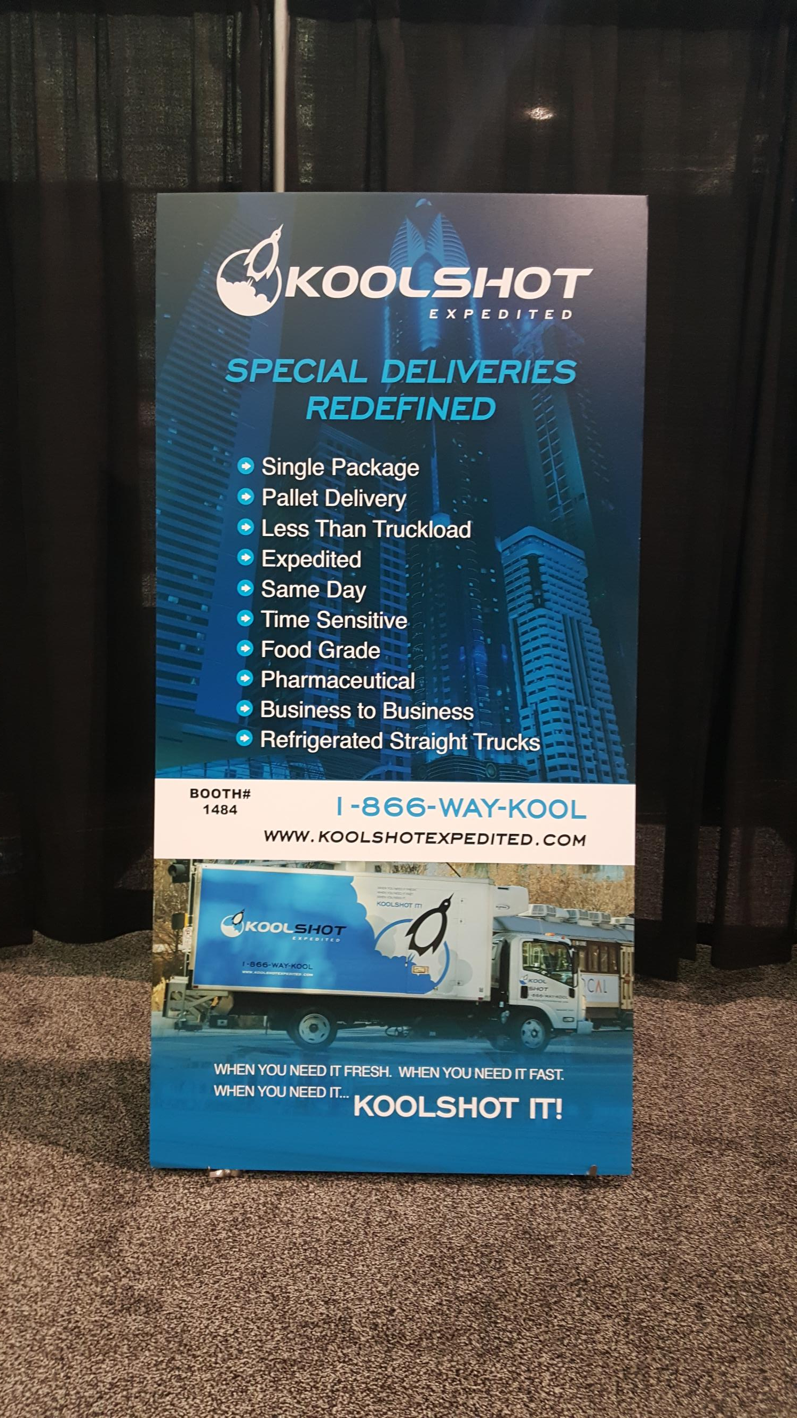
1 Meter Panel Promotion
$3,700
The 8ft × 3ft double-sided panel will receive significant exposure, attracting a large volume of buyers.

Slide 7


Poster Display 2x3’ or 3x2’
All photographs must be mounted on foam board; metal or glass frames WILL NOT be allowed
Maximum frame size is 2’(length) x 3’(width) or 2’(width) x 3’(length)
Do not provide frames with hanging wire or hooks
Be sure to have Velcro on the back of the poster
Have your booth # on the poster
DO NOT BEND the poster. We want the poster to look presentable
Each display includes a standardized name sign and product name
Poster display must be delivered to New Product Location, booth# TBD by 2:00 pm on Saturday, March 14, 2026.
PLEASE DO NOT SHIP YOUR POSTER TO THE EVENT
MANAGEMENT IN PORTLAND— WE CANNOT
DELIVER YOUR MATERIALS TO THE CONVENTION

Slide 8

New Product:
New Products must have been introduced to the market within 18 months of the event.
Featured Product:
Featured Product Showcase is designed to highlight and give your company the opportunity to promote their FINEST/BEST products to potential buyers regardless of the product’s introduction date.

Slide 9


For more information please contact: Minh Ly-Gordon
+1-207-842-5525 or mlygordon@divcom.com
Deadline: Thursday, February 5, 2026

