Slide 1

New Product automatic entry to the prestigious Seafood Excellence Awards (Food Sector Only). The competition is designed to help the company that wins the competition receive additional press coverage and attention from buyers attending the Seafood Expo North America.
New/Featured Product Showcase $700 per entry.
Deadline to apply for New/Featured Product Showcase: Thursday, February 5, 2026.
The number ONE reason buyers come to the show is to see your New/Featured Products!
Key Buyers Need Convenience
Increase Your Product Awareness
Increase Sales
Reach New Buyers

Slide 2
New and Featured Product Showcase Floor Plan

Slide 3
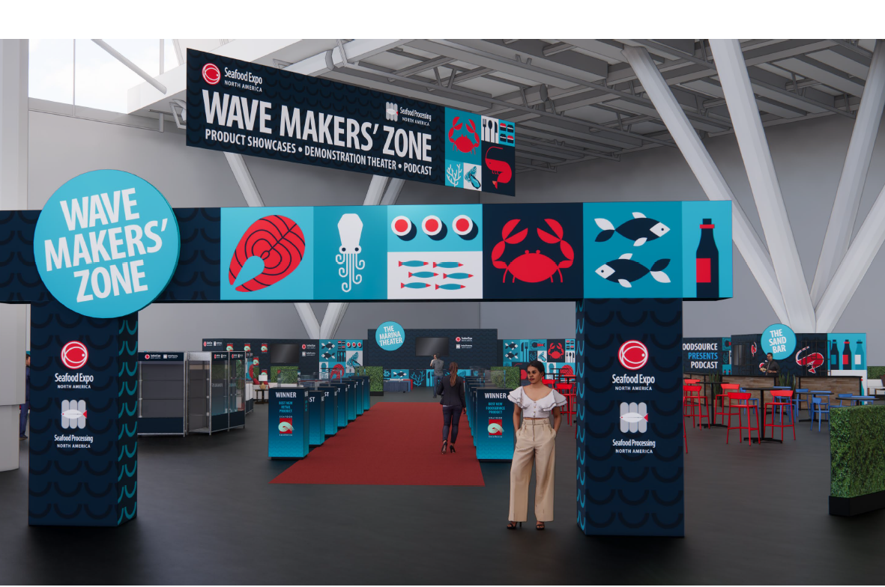

Slide 4
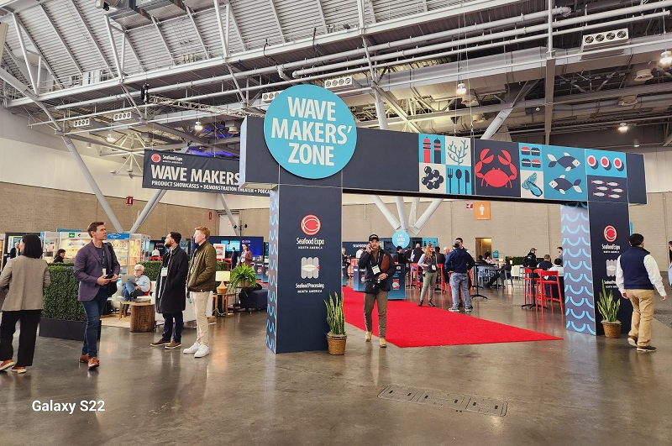

Slide 5
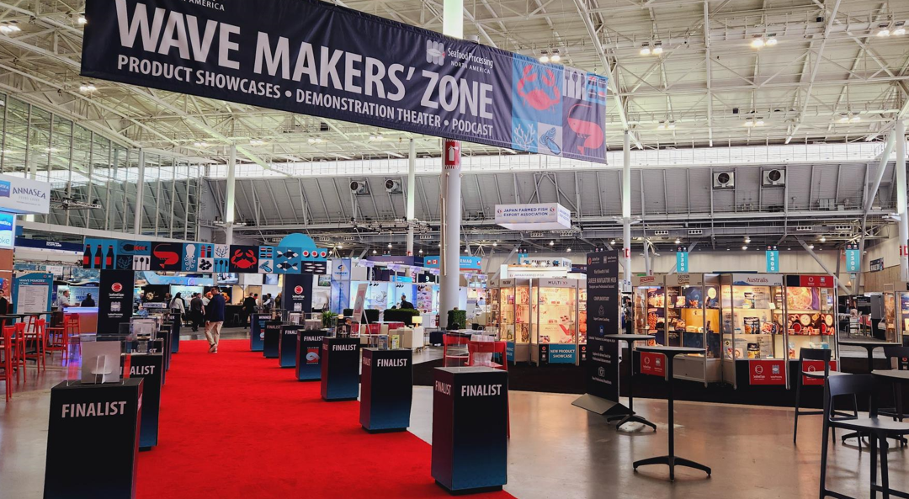
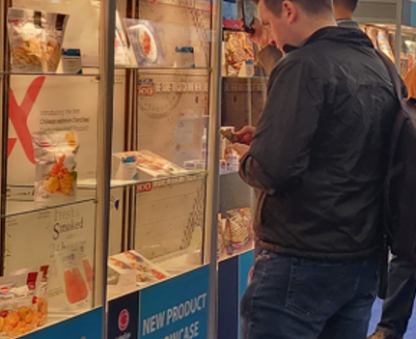
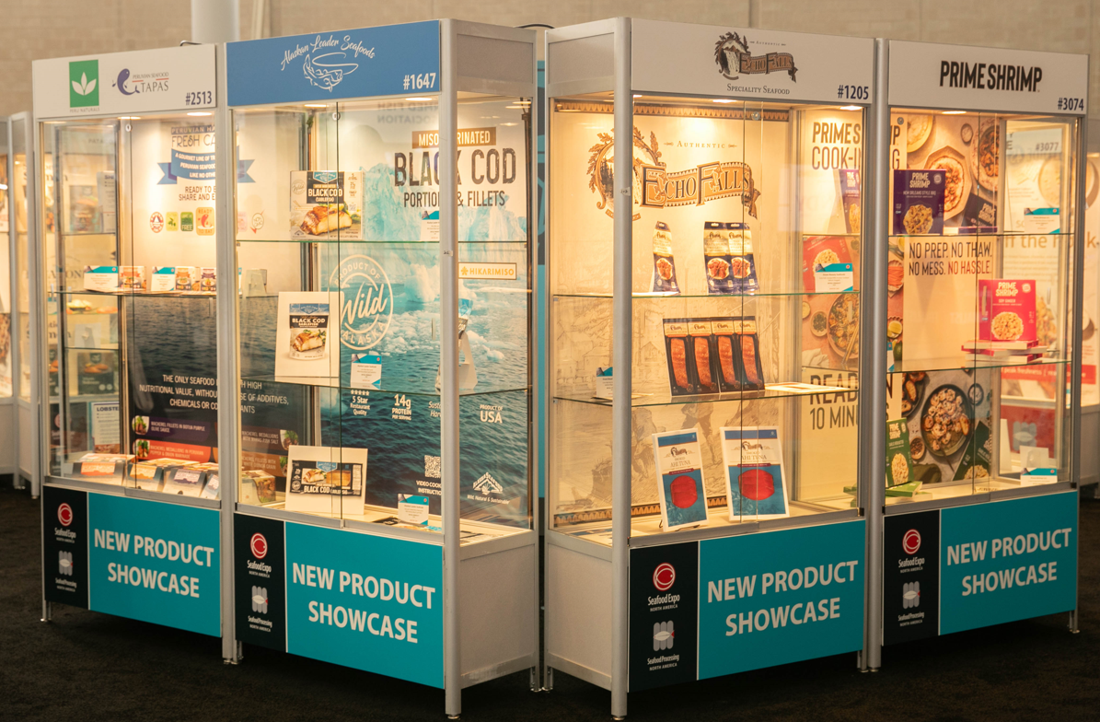
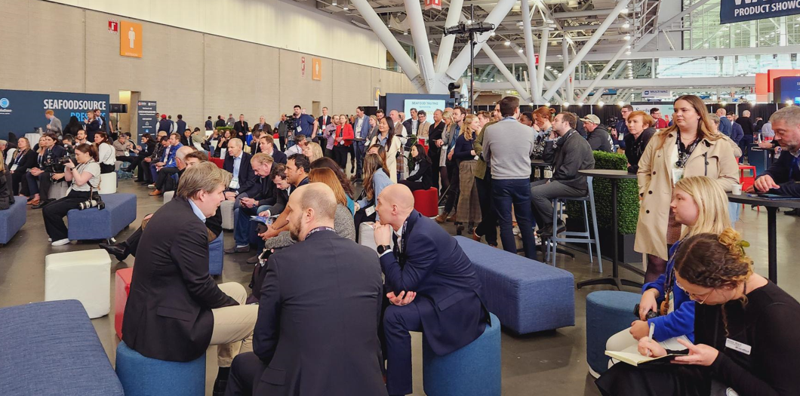

Slide 6
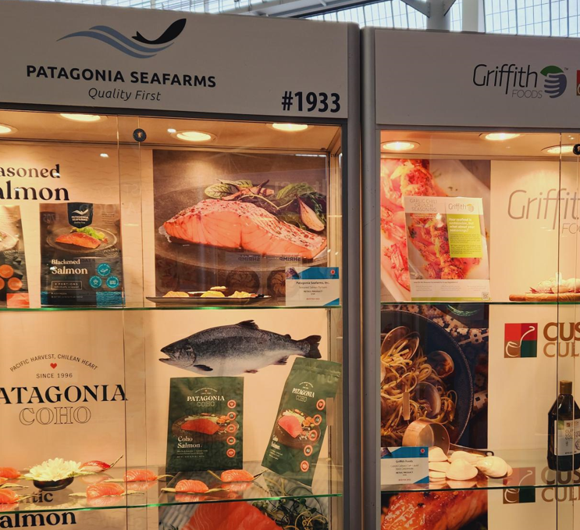
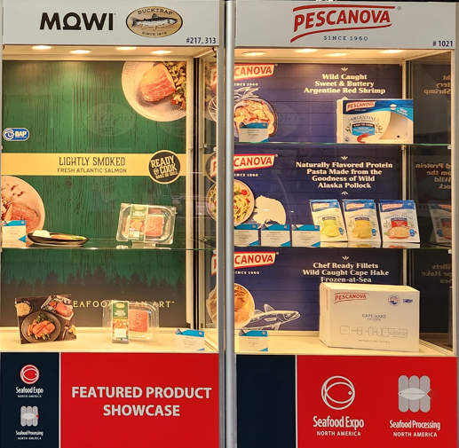

The Wave Makers' Zone is a popular networking hub for industry leaders. Take full advantage of this heavily trafficked area by introducing buyers to your latest innovative products in the New/Featured Product Showcase.

Slide 7
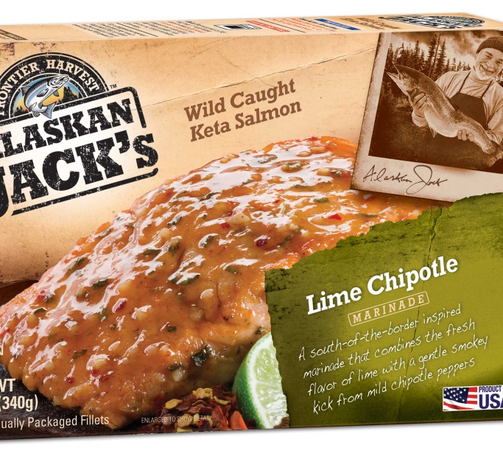
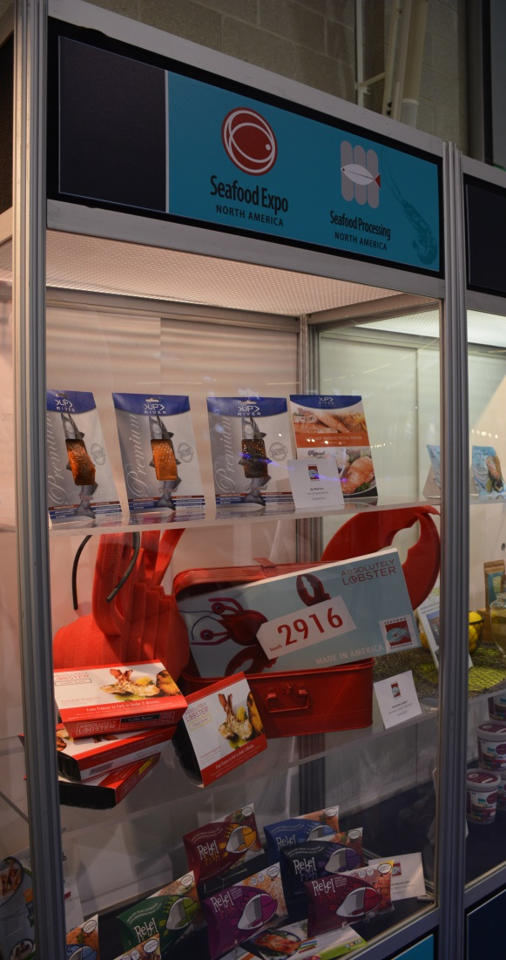

Single Display - $700 per entry
Display products must be non-perishable
Recommended: display empty product packaging.

Slide 8
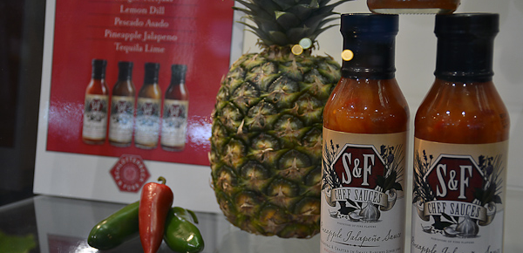


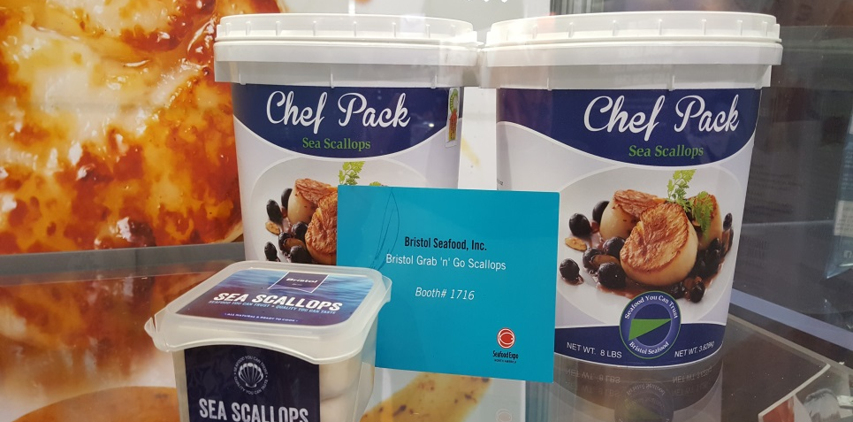
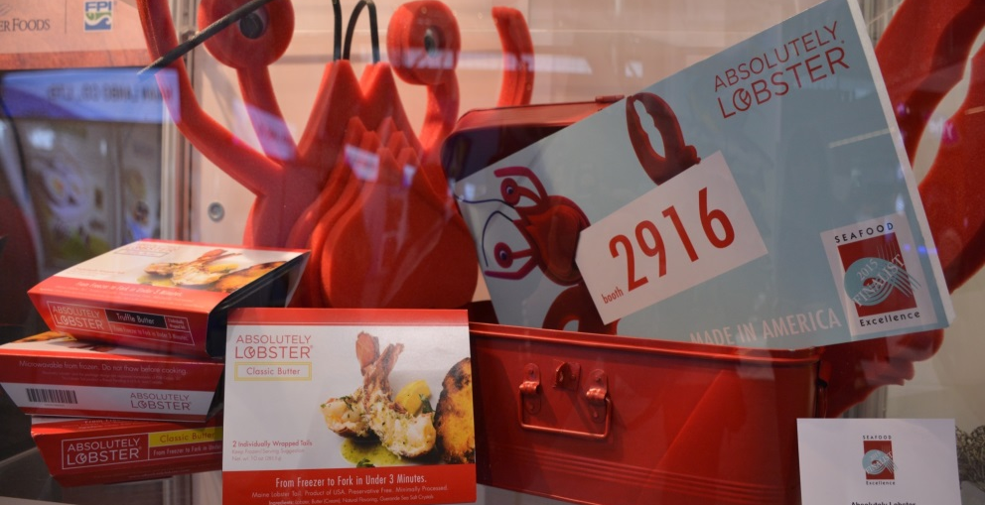
Single Display $700 per entry

Slide 9

Half Poster Display
2x3’ or 3x2’
$700 per poster

Slide 10
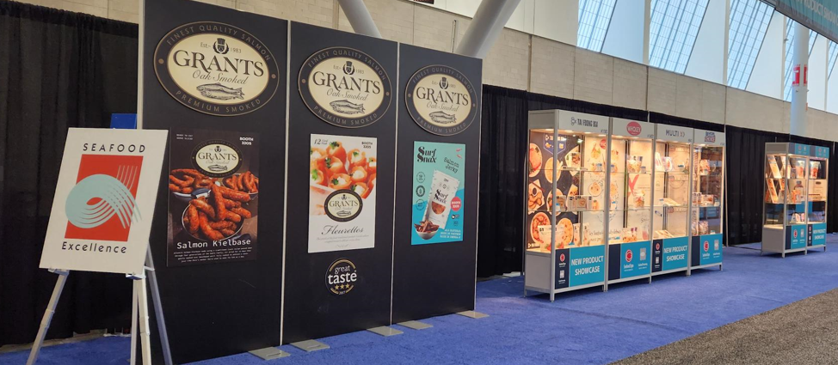
Full Poster Vertical Display 3x4’ $1,115 per poster

Slide 11
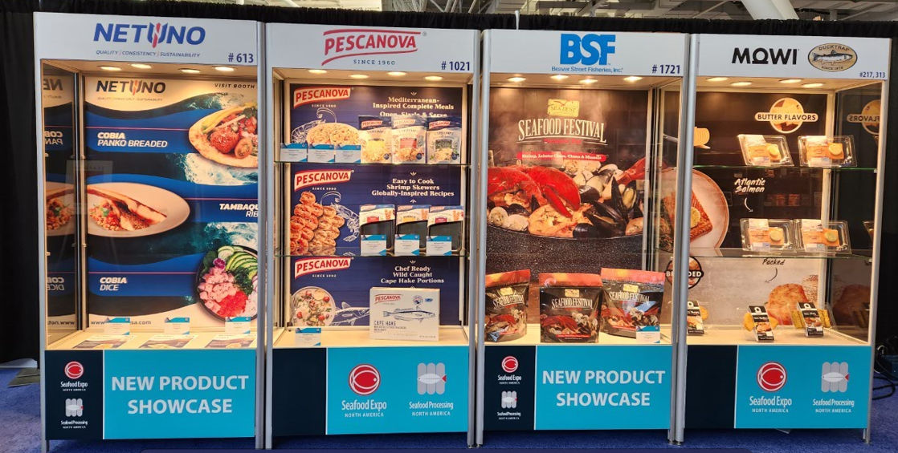
Showcase Branding Opportunity. With this sponsorship, you receive one showcase highlighting up to 3 products. The showcase’s top will feature your company name, logo, and booth number. Sponsorship Fee: $3,165

Slide 12
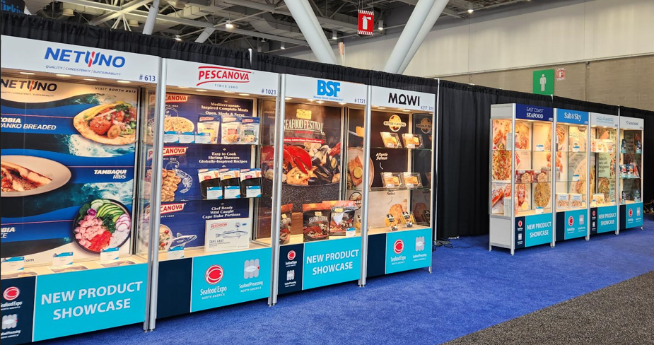
Showcase Branding Opportunity is one of our most popular promotions!

Slide 13
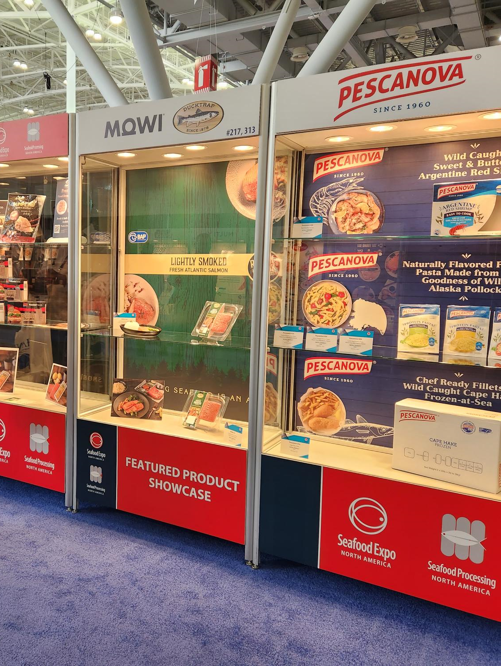
Featured Product Showcase is designed to highlight and give your company the opportunity to promote its BEST products to potential buyers regardless of the product’s introduction date.
$3,165

Slide 14
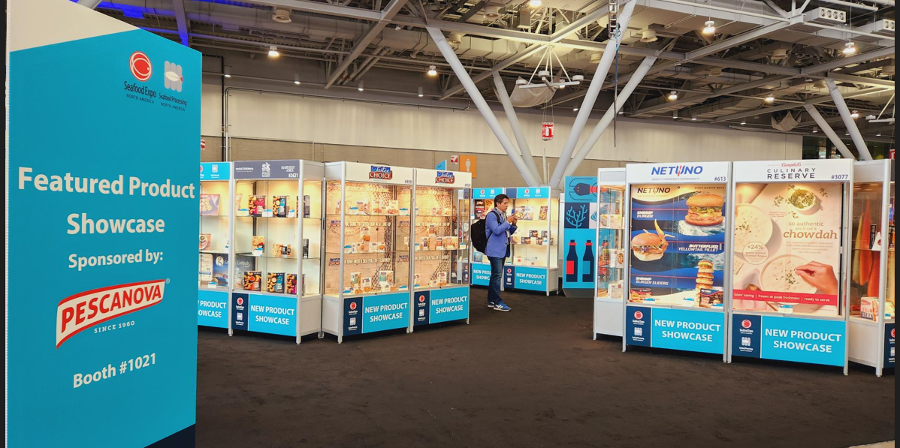
The product showcase is the number one place buyers and visitors will never miss!
Make it easy for the buyers to find you!

Slide 15
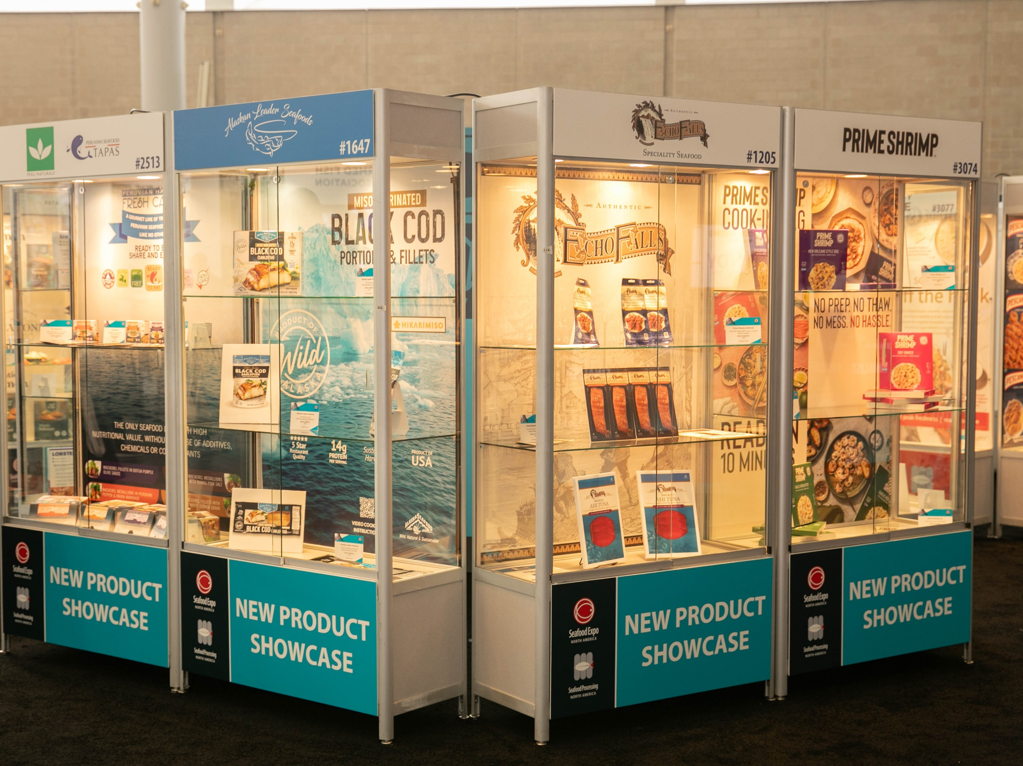

Slide 16
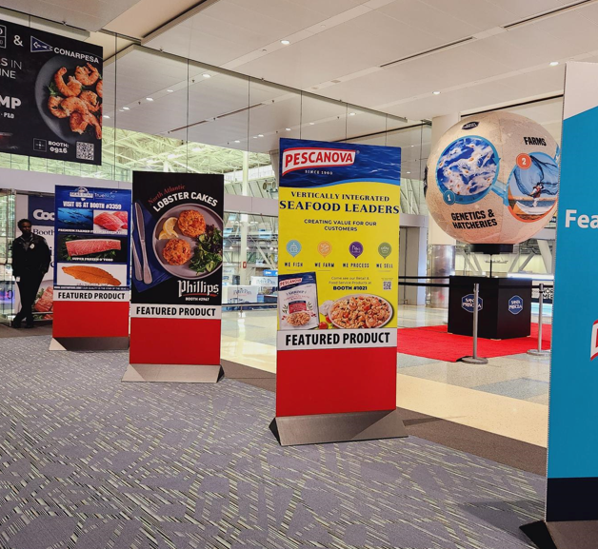
1 Meter Panel Promotion Double Sided $3,700
The 8 ft x 3 ft double-sided panel will receive lots of exposure, attracting a large volume of buyers.

Slide 17
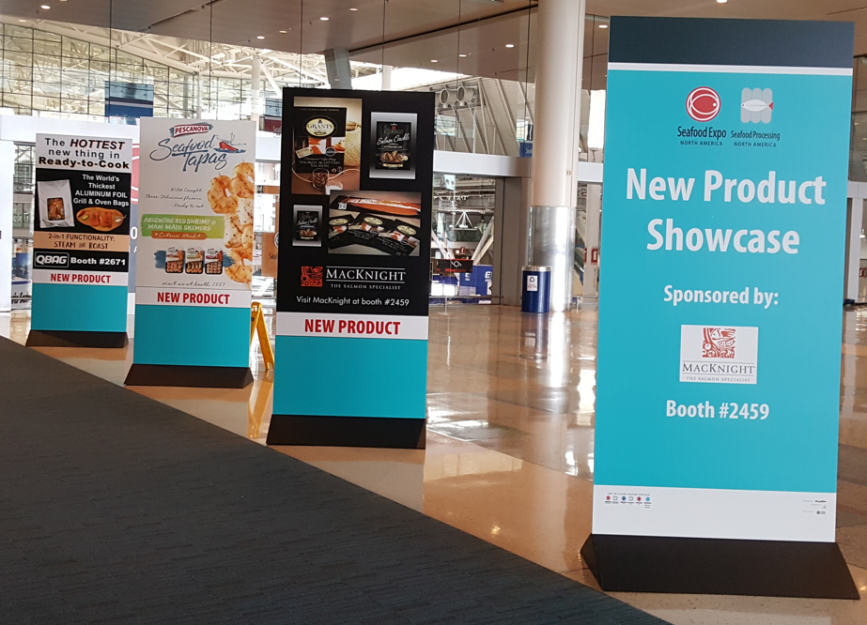

Slide 18
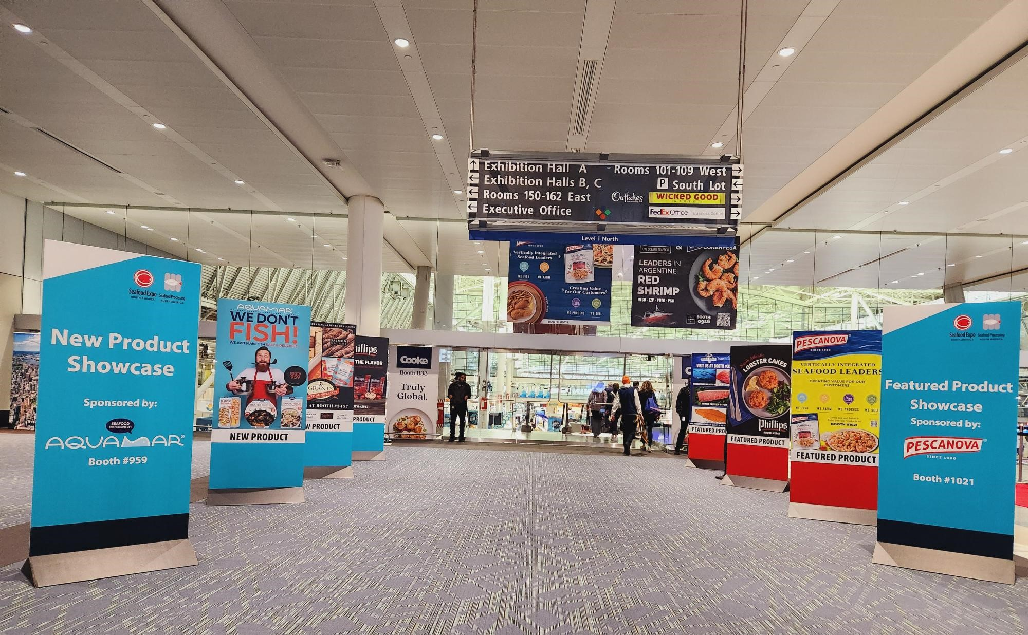

Slide 19

Key Buyers Digital Mailing Promotion:
An opportunity to promote your products 3 weeks in advance before the expo opens.
Sponsorship fee: $3,075

Slide 20

 | 2026 Pricing
New/Featured Product Showcase (single shelf) | $700
New/Featured: Half Poster (2ftx3ft or 3ftx2ft) | $700
New/Featured: Full Poster 3ftx4ft (Vertical only) | $1,115
New/Featured: – Branding Opportunity | $3,165
North Lobby Full Panel ( Double Sided 8ft x 3ft) | $3,700
New/Featured: Key Buyers Digital Promotion HIGHLY RECOMMENDED! Direct exposure before the expo starts. Only limit to 2 companies. | $3,075
New Product Showcase Exclusive Sponsorship Featured Product Showcase Exclusive Sponsorship | SOLD OUT $6,770

Slide 21
New Product:
New Products must have been introduced to the market within 18 months of the event. All products entered into the New Product Showcase are automatically entered into the Seafood Excellence Awards competition. Products entered must be edible in order to participate in the Seafood Excellence Awards competition.
Featured Product:
Featured Product Showcase is designed to highlight and give your company the opportunity to promote its BEST products to potential buyers regardless of the product’s introduction date.
Featured Product WILL NOT be eligible to enter the Seafood Excellence Awards competition.

Slide 22


For more information, please contact: Minh Ly-Gordon
+1-207-842-5525 or mlygordon@divcom.com
Deadline to apply for New/Featured Product Showcase:
Thursday, February 5, 2026

